Slide 1
CITY OF WHEELER EMERGENCY CONSIDERATIONS APRIL 2024
FACTS
City is responsible for health and safety of the community
Emergencies require preparation to provide public safety
Earthquakes or fires could occur any day
Natural disasters would displace hundreds of people
Displaced people need shelter, water, food, sanitation facilities,
supplies for warmth, hygiene, lighting and first aid

Slide 2
LOCALIZED RESPONSE
INDIVIDUAL RESPONSIBILITY
ASSEMBLY AREAS
TEMPORARY ENCAMPMENTS
FIRST RESPONDERS
EVCNB CERTS
LOCAL MRC
health

Slide 3
INDIVIDUAL RESPONSIBLITY
Minimum 30-gallon water per person/ pet on site
Minimum 30 day shelf stable food supply on site
Food preparation supplies
Written plan for next steps
WHEN LEAVING SHELTER
Go Bag prepared with minimum 3 days food and water
30 days supply of medication
Prescription eyewear/ hearing aids
Bring GMRS radio and extra battery
health

Slide 4
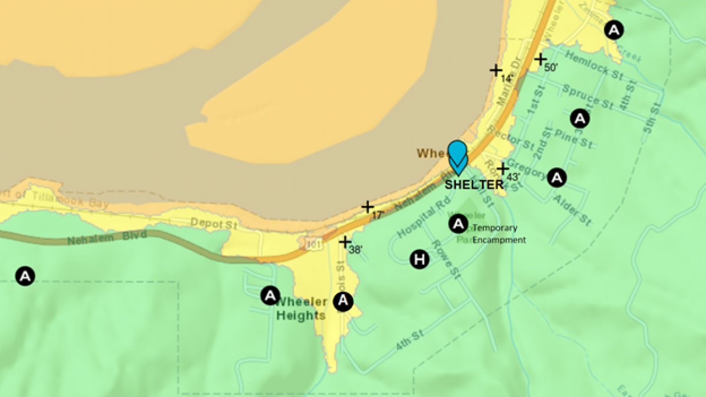

Slide 5
ASSUMED IMPACTS NEHALEM BAY
All roads north/ south and east impassable
Electrical grid severely compromised
Sewer and water lines destroyed
Ground subsides 3-8 feet
Landslides and liquefaction expected
Housing damaged by earthquake ( not livable) 20%
Housing in inundation zones 55%
Communication extremely limited

Slide 6
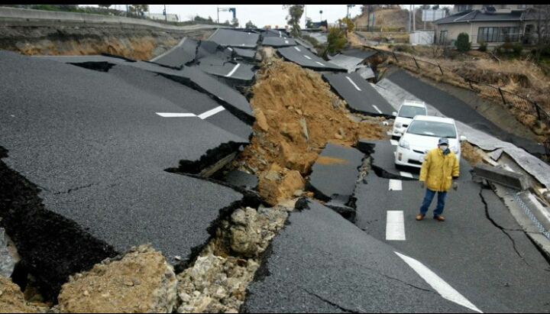
SEVERE TRANSPORTATION IMPACTS

Slide 7
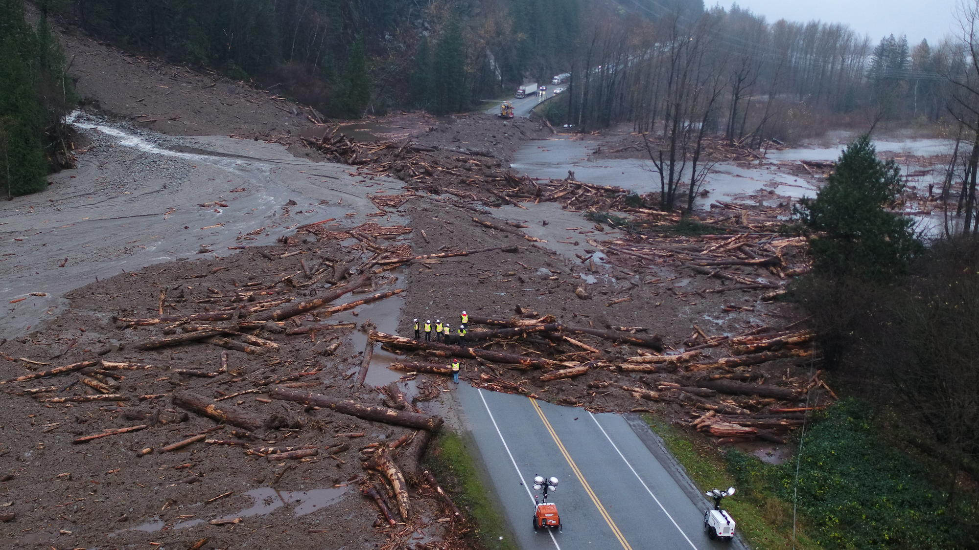
EXPECT LANDSLIDES AND DEBRIS FLOWS

Slide 8
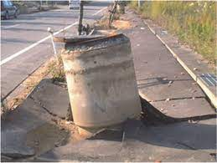
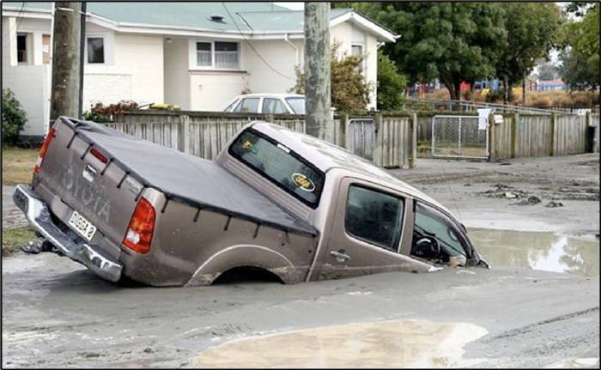
AFTER EFFECTS OF SEISMIC ACTIVTY SUBSIDENCE LIQUEFACTON

Slide 9
ASSUMED IMPACTS TO WHEELER
Homes earthquake damaged (unlivable) * 42
Commercial buildings damaged (hazardous) * 14
Casualties Fatalities * 4
Injuries * 18 (requiring medical attn.)
* Assuming no major slides
Displaced people requiring shelter, hydration, food,
medical care, access to sanitation stations 220
Study data show no tsunami casualties for Wheeler

Slide 10
WHEELER RESILIENCE EFFORTS TO DATE
WET is doing great emergency preparedness work
Supplies accumulated are valuable community resources
Two reservoirs each with 250K gallon capacity
Reservoirs constructed in 2003
Current demand 50-70K gallons/ day
Local residents have capability to isolate tanks
Each reservoir fitted with 2-inch standpipe for on site distribution

Slide 11
INCREASING WHEELER RESILIENCE
Consider Sourcing:
Soft sided shelters
Septic system for upper park
Agua Munda water filtration units
Solar generators
Solar powered area lighting
Food safe water barrels
MRE’s
Handwash stations

